Slide 1
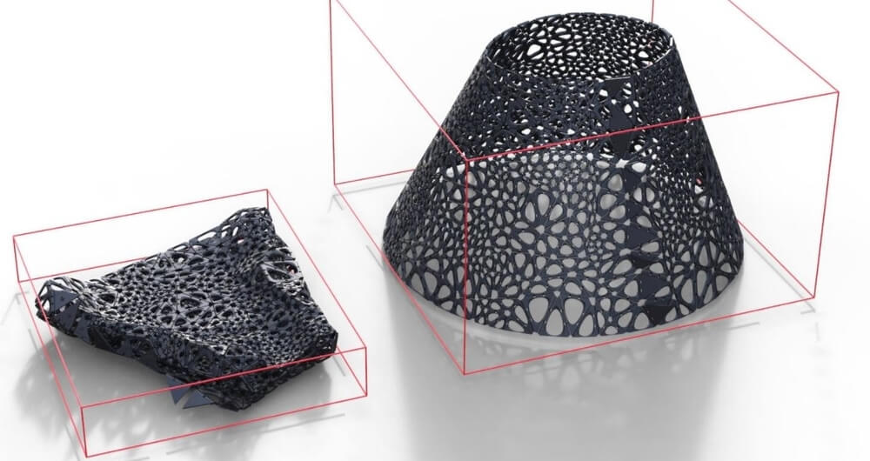
4d Printing
By Eli Rankin

Slide 2
Overview
History - slide 3 and 4
Impacts - slide 5,6 and 7
Pros - slide 8
Cons - slide 9
Summary - slide 10
References - slide 11

Slide 3

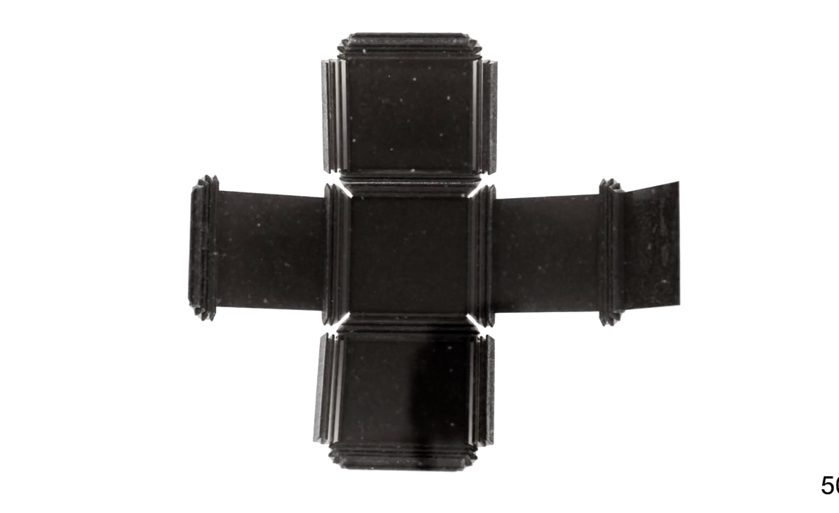
History
Skylar Tibbits
Ted conference in 2013
Notes:
4d printing was created by Skylar Tibbets of MIT’s self assembly lab presented in a TED conference in 2013
By 2015 4d printing has been able to change shapes which is paving the way for aerospace, healthcare and construction.
Ongoing research for 4d printing is still happening by testing designs, materials and structures.
It was named 4d printing for its ability to change shapes over time

Slide 4
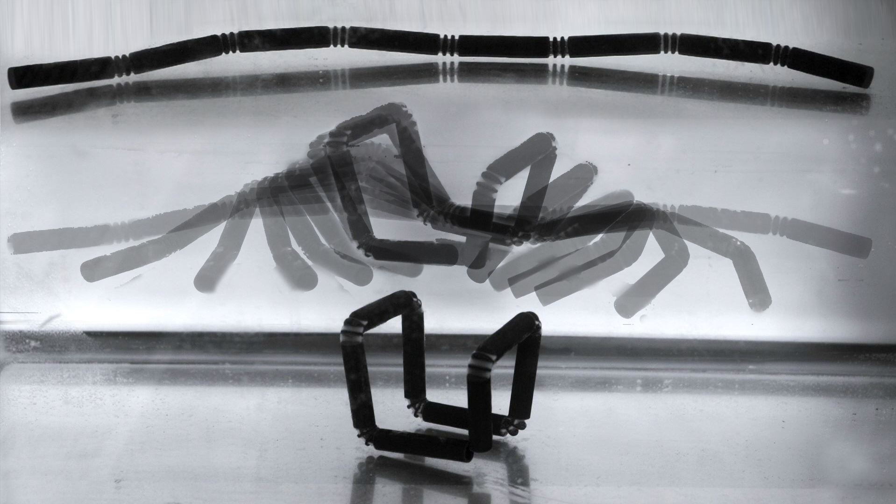
How was it created
Testing different materials and shapes
Reacting materials
Notes:
4d printing emerged after using different materials and shapes in 3d printing.
Early experiments involved seeing which materials could react to different temperatures, humidity and light.

Slide 5
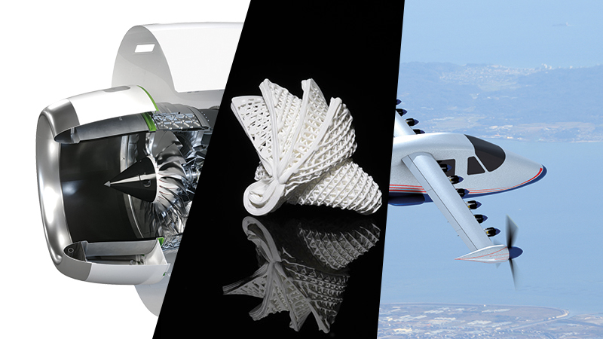
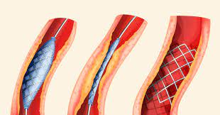
Impacts - Who?
Industries
Aerospace
Architecture
Healthcare
Construction
Notes:
4d printing will impact many industries by revolutionizing aerospace, architecture, healthcare, manufacturing along with many more.
For example in aerospace 4d printing could create lighter and more flexible parts in planes.
This will also help researchers and engineers by presenting new opportunities and challenges to overcome.

Slide 6
Impacts - What?
Society
Environment
Notes:
Sustainable infrastructure
Advanced healthcare
Dynamic and responsive structures that will change the environment
Reducing material waste
Reducing energy consumption
More efficient use of materials
Minimize environmental footprint

Slide 7
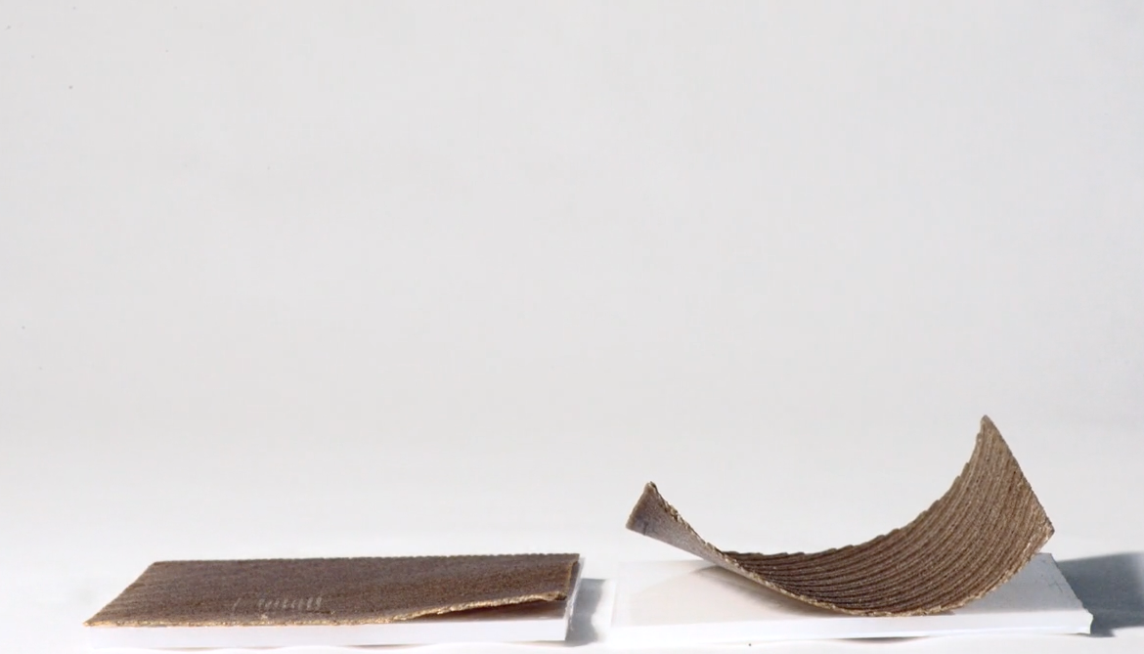
Examples of 4d printing
Self repairing pipe system
Self assembling furniture
Notes:
A self repairing pipe system would work by the pipe changing it’s diameter in reaction to the flow rate and water. Pipes could also possibly heal themselves if any cracks or breaks appear in the pipe
Since 3D printing furniture is limited by the size of the printer, 4D printing could allow to just print a flat board that will curl up into a chair by just adding water or light to it.

Slide 8
Pros
Design flexibility
Adaption to environment
Customization
Efficiency
Notes:
Upsides/Pros:
1. Design Flexibility: 4D printing offers design flexibility, allowing for the creation of complex structures that are difficult to achieve with traditional manufacturing methods.
2. adaption: Objects made through 4D printing have the ability to self-assemble and adapt to their environment, which helps in areas such as architecture, robotics, and medical engineering.
3. Customization: 4D printing allows customization at a level not possible by 3d printing, customization such as using different materials and designs is available with 4d printing
4. Efficiency: By using materials and designs, 4D printing has the potential to increase efficiency in manufacturing processes, leading to cost savings and reduced waste.

Slide 9
Cons
Material limitations
Complexity and cost
Reliability and durability
Notes:
Downsides/Cons:
1. Material Limitations: Current 4D printing technologies are limited by the availability of materials that are used in 4d printing. making new materials with desired properties remains a challenge.
2. Complexity and Cost: The design and production of 4D printed objects can be complex and expensive, requiring specialized equipment and skill. This could limit accessibility, particularly for smaller businesses and startups.
3. Reliability and Durability: The reliability and durability of 4D printed structures may be a concern, especially in critical applications such as aerospace and healthcare. Ensuring the stability and performance of these structures over time is a significant challenge.

Slide 10
Summary
I am for 4d printing
Design innovation
Sustainability
Notes:
Slide 1: Advantages of 4D Printing
1. Design Innovation: 4D printing gives design flexibility, which allows for the creation of structures that adapt to their environment. This innovation opens up to new possibilities in architecture, product design, and robotics.
2. Sustainable Solutions: By using changeable materials and reducing waste in the production process, 4D printing promotes sustainability. It aligns with the growing emphasis on eco-friendly practices.
As i agree with the idea of innovation and new possibilities I think that 4d printing is a great way of doing this so I am for it.

Slide 11
References
4D Printing: All you need to know in 2023
What Is 4D Printing?
4D printing: Is this the Fourth Industrial Revolution?

